Slide 1
WARNING
These slides are not optimized for printing or exam preparation. These are for lecture delivery only.
These slides contain a lot of animations. For optimal results, watch in slideshow mode.

Slide 2
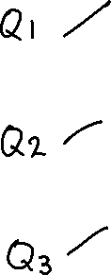
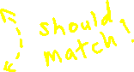
CS2103/T Week 4 →5 Briefing
[Sep, 2024]
[50 minutes]
Which class diagram(s) match the object diagram?
(a)
Foo
Bar
1..*
*
(b)
Foo
Bar
*
1..*
*
1..*
(c)
Foo
Bar
1
*
Class diagram → class structure implemented in the code
Object diagram → object structure at run-time
:Bar
:Foo
:Bar
Learning outcome → able to verify they match

Slide 3

Answer this in the Canvas quiz
1
1. The class diagram matches the given object diagram
True
False
Foo
Bar
1..*
*
Approach: check different aspects (classes, associations, navigabilities, multiplicities, …) until you find a mismatch.
:Bar
:Foo
:Bar

Slide 4
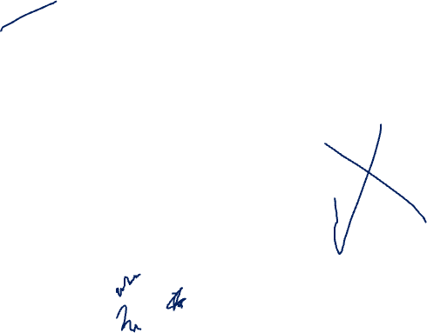
2
2. The class diagram matches the given object diagram
True
False
Foo
Bar
*
1..*
*
This says a Bar should be connected to at least one Foo. Agree?
Remove this too?
:Bar
:Foo
What if we remove this? Still compliant with the class diagram?
:Bar
Remove this too?

Slide 5

3
3. The class diagram matches the given object diagram
True
False
1..*
Foo
Bar
1
*
:Bar
:Foo
:Bar

Slide 6
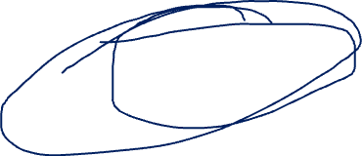
Tough week in the iP?
Good news: Technical difficulties wise, last week can be considered the high bar for the semester.
If you survived it, you can survive the rest (unless you make things harder by yourself).
If you are struggling, there is still time to catch up.
One safety-net (i.e., 1-to-1 debugging help from tutors) removed.
Another (i.e., forum) is provided, but do keep increasing your self-reliance.
If you posted an issue and it got resolved. What next? 1. Learn from it. 2. Help others with similar issues.
Notes:
Progress Observation: The next few weeks of the project (IP) won't introduce concepts harder than what’s already been covered. Those progressing well will continue smoothly.
Catching Up: About half of the class hasn’t delivered everything due, but that’s expected by design to encourage students to push harder in this phase, with a few weeks left to catch up. Instead of alerting near deadline, we want to signal you now. The goal is to avoid falling behind later near deadlines.
So not to worry, not to stress if you are here. but try to catch up now.
Technical problems: Half the class has done it. Half the class hasn't done it. So, you know, there's like almost one to one people ready to help the other half you just have to ask. and something related to that. And this, this slow, slow progress could be. Because of this, we removed this one safety net. But we replaced with forums.
Self-Reliance Focus: While help is available on forums, students should focus on understanding how problems were solved, increasing self-reliance, and helping others in the future.

Slide 7
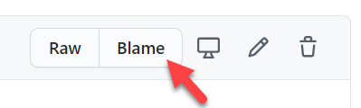
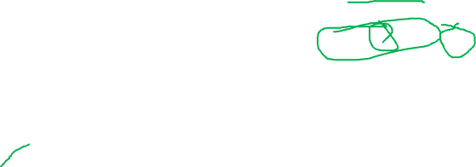
4
Git and GitHub has a feature called blame. What does it do?
Last known good commit
Bug detected!
Which commit introduced it?
Tells you who edited each line
Helps you do a binary search of the commits to locate the commit that introduced a certain behavior to the code base
Why?
This Git feature is called bisect
e.g., to learn what lapses caused it to happen to find author/reviewers accountable
to decide who should fix it
Notes:
Git Bisect Feature: The Git bisect command helps identify which commit introduced a bug by using a binary search method to narrow down where the bug first appeared.
Purpose of Identifying Bug Introduction: Finding the commit that introduced the bug is useful for understanding its origin, preventing similar issues in the future, and maintaining code quality.
How Git Bisect Works: You provide Git with a known commit without the bug and the commit where the bug was detected. Git then checks out the midpoint between these commits and asks you to confirm whether the bug exists.
Binary Search Process: By repeatedly checking the middle commit, Git narrows down the range of commits until it pinpoints the exact commit that introduced the bug.
Efficiency of Git Bisect: The binary search approach is much faster and more efficient than manually checking each commit individually, making it a powerful debugging tool.
Anyway, this is this is a totally different thing about Git.
What do you think?
even if you don't know this feature
from the name, you can guess that's what it does.
The second one is also actually a feature
which tells you.
suppose you detected a bug bug in a certain commit. It tells you
which commit actually introduced that bug because it could have been much earlier. Right?
So one question is, why do you even bother? You find the bug? You fix the bug.
Why do you go and waste time figuring out where it was introduced? Well, there are some reasons, good reasons for this.
as you can see down here.
and other reasons. Alright. So
this is done.
and in fact, the feature is called bisect. Git bisect
how it works is.
So you detected the detected the bug here right? That much, you know, but you don't know is where it was introduced.
You need to find one more thing.
one commit that doesn't have the bug.
Alright. Perhaps you're
at the last release, the previous release. 7 days ago we tested for this. It wasn't there
even even this feature wasn't there? So definitely. This bug wasn't there. you know you can easily find such a commit right
now. The question is, where? Where was it introduced? Not to worry? You run this feature, and and what git will do is it will automatically check out the middle commit between this and this
right which is the midpoint commit.
and then ask you, okay, check. Now tell me whether the bug is there or not. so you'll be testing code somewhere here.
You just have to run the same test, or somehow find whether it's there or not. And then Tellgate be honest.
If you say yes, it is there, then it will pick. So let's say we are here.
The bug is still there, so that means it was introduced
in this part. Right? So git will pick the middle one from that
branch.
check that out, check out that that commit, and then ask you again. Alright, now, is it there?
So that's how it works.
it'll continuously keep keep asking, is it there? And pretty soon we'll figure out it will figure out which committee it is, and then tell you.
That's how binary search works
you. You remember this right? So
if you ever wondered what's the use of this thing? But you have to go through this binary search crap. Yeah.
this is one use.
So it's it's much more efficient than
checking randomly or checking each commit at a time.
Anyway, the answer is this one for this question.

Slide 8
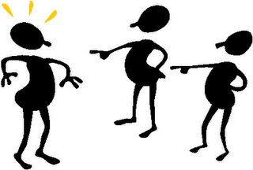
You need to be able to do stuff!
Bug detected!
You introduced it!
But… but… I scored good grades for all my courses!
Focus on learning!
Score more with less work? Not necessarily. Learn more with less work? YES!
Notes:
What’s next?
If you were the one introduced the bug, then you need to know how to fix it. You need to be able to do the stuff! Especially in technical jobs.
Focus on learning
Score more with less effort → copying quiz ans from friends
Learn more with less effort → asking friends to explain some concepts
Don’t think too short term to get good grades in this course, instead focus on your ability to learn faster with less mark.
Talk about the Mentorship Programme here

Slide 10
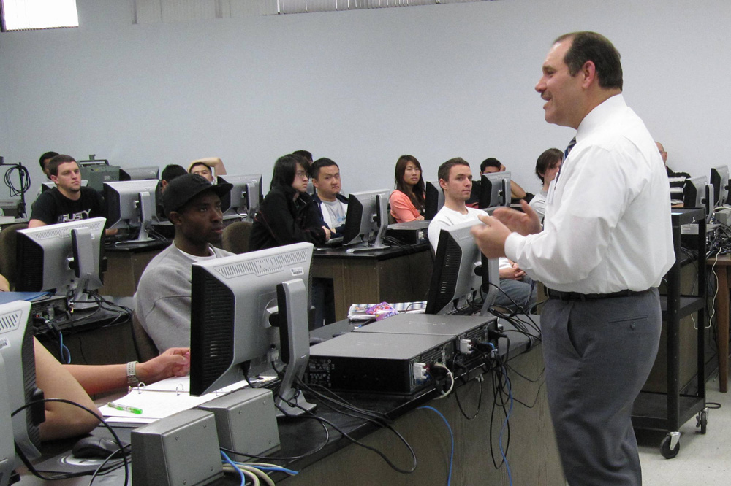



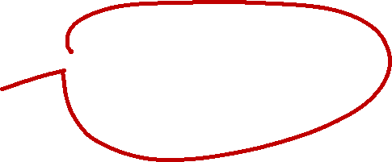


Notes:
Looks like CS class – programming class
Prof is happy, students are sad ☹
Prof is saying to students on something to do.

Slide 11
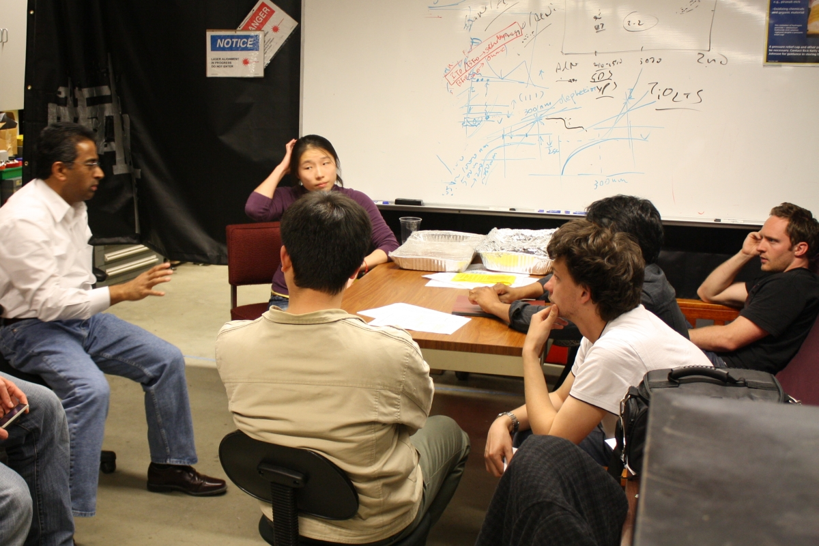
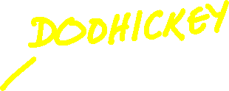
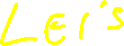

Notes:
In practice, there will be no one to tell you what to do
In real projects you need to figure out what to do
That’s what we are going to do in the coming weeks

Slide 12
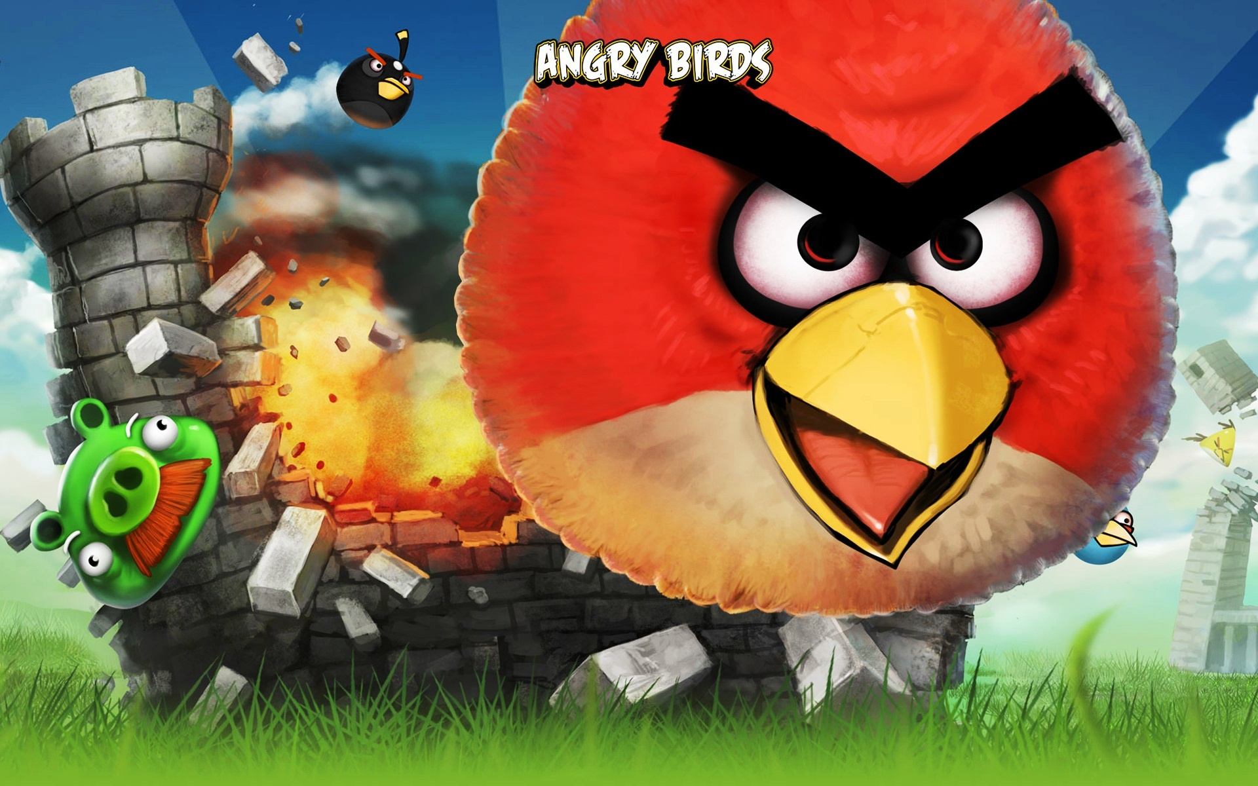
1 billion downloads
Notes:
This is a popular game, 1 billion downloads, even there are some movies after this game.

Slide 13
Notes:
Very popular game – I played this during my PhD ☺

Slide 14


APP
49
Angry dogs
APP
50
Angry bulls
FAIL
FAIL
WIN
Notes:
Before this game, the company tried nearly 50 games and got failed.
Probably there is money left to develop one more game and they succeeded. If this got failed, we might not even know this story

Slide 15

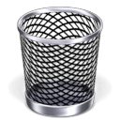
FAIL
WIN
Notes:
Even big companies like apple, google, Microsoft, etc. failed in their products.
Anyone who know this?
Google’s wave product – failed within one month of its launch
What is the reason?

Slide 16
Requirements
Not easy!
Notes:
Answer is Requirements.
Initially you might think CODING is harder, then DEBUGGING is harder, then maybe GRADDLE is harder or even GIT is harder.
Eventually, you will realize that gathering REQUIREMENTS is harder than those.
If this is not done properly, then the product is failure irrespective of what technical aspects you have in your product.
These are technical difficulties which you can eventually fix it.
Gathering good requirements is most challenging because: Gathering good, accurate requirements is more difficult because it involves potential misinterpretations or hallucinations about what is truly needed.
Teams may misinterpret or misunderstand what the stakeholders want, leading to incorrect or incomplete requirements.

Slide 17
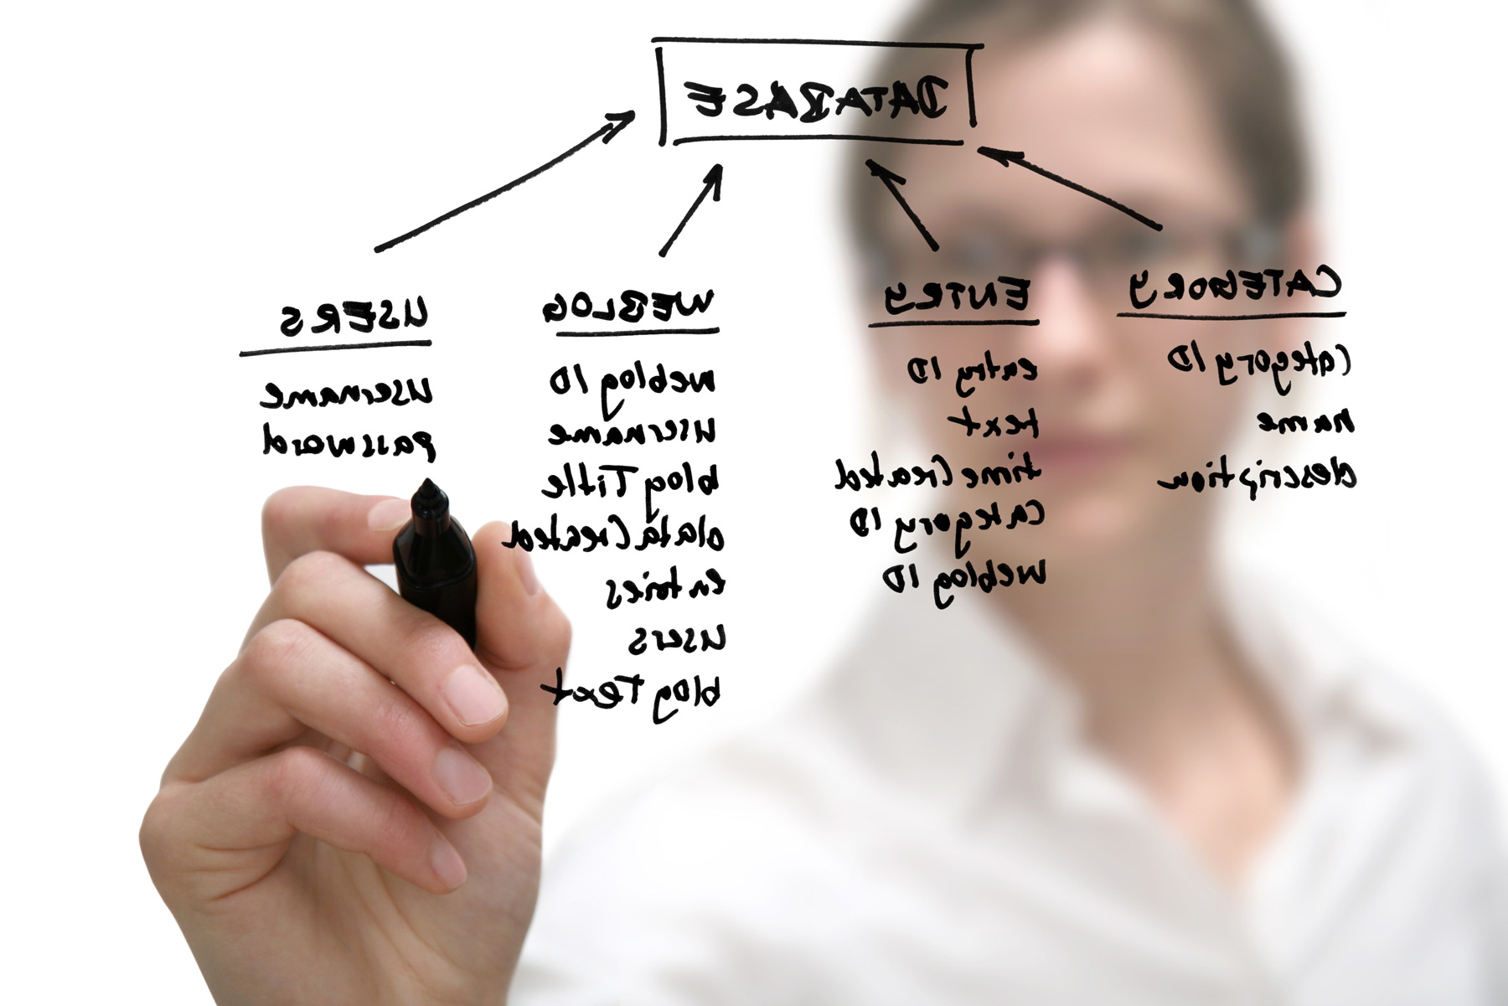
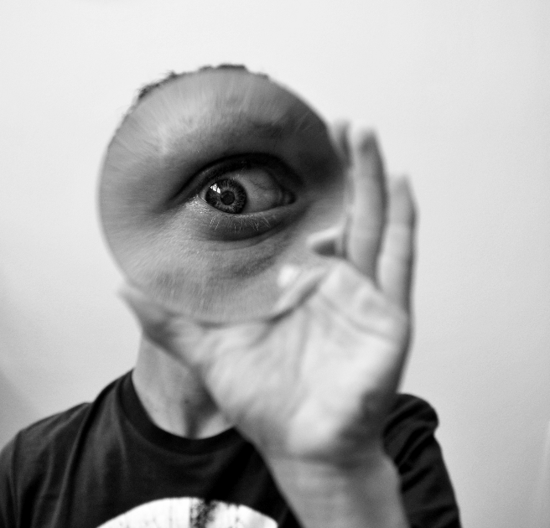
Notes:
Two Aspects of Gathering Requirements: The process involves two main activities: 1) Establishing requirements and 2) Specifying them.
Establish Requirements: This refers to gathering initial requirements from stakeholders or users, which serve as a basis for understanding what the system should do.
Specify Requirements: Once gathered, requirements are specified in a formal format, then shared with others to get feedback, allowing for refinement.
Cyclic Process: Establishing and specifying requirements are interrelated and form a continuous cycle where the requirements are iteratively refined through feedback.
The requirements gathering process may vary between iterative development models (such as Agile) and traditional models like Waterfall.

Slide 18



ESTABLISHING requirements
SURVEYS
INTERVIEWS
FOCUS GROUPS
PROD. STUDY
OBSERVE
BRAINSTORM

Slide 19



SPECIFYING requirements
PROTOTYPES
+
TEXT
FEATURE LIST
USER STORIES
↓
↓
+
In a later week
GLOSSARY
SUPPLEMENTARY

Slide 20
There are two ways to do this one:
☺ The expected way
☹ The short way
☺ The expected way
Notes:
Week 5 Topics: The first part of this week focuses on methods for gathering and specifying requirements.
User Stories: You are required to come up with user stories, which are a common technique for gathering and specifying requirements.
Two Approaches: There are two ways to write user stories: the expected, thorough way, and a shortcut method.
Evaluating User Stories: By examining the quality of your user stories, it will be possible to identify which method you used for gathering requirements.
Please Focus on getting Quality User Stories

Slide 21
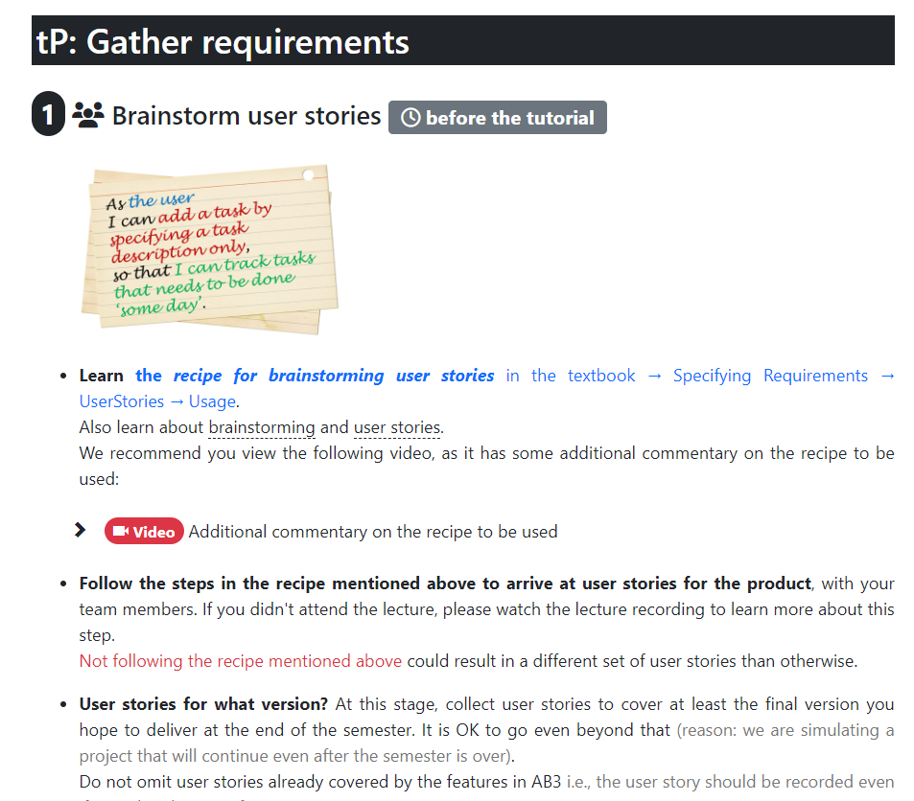
Notes:
How get quality US is explained in this section, we have an additional video that explains this.

Slide 22
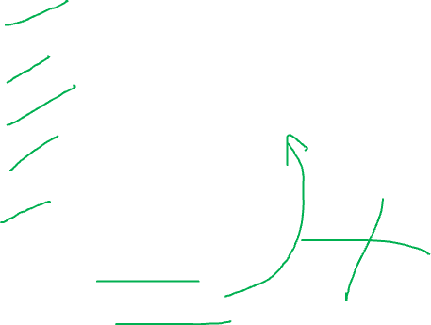
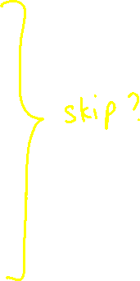
5
tP tasks for this week
Define a persona
Define the problem scope
Write a narrative
Extract user stories
Select smallest set of user stories
Define features
Define UI commands
Notes:
After this week, you are supposed to complete until “Select smallest set of US”.
We will do the remaining two sections later.
Can you skip this and go directly to defining the features?
For example, you define the feature and through reverse engineering you try to come up with the user stories.
This is not the right way to do it.

Slide 23
Notes:
This part is on Requirement gathering and specifying.
This is needed for your TP.

Slide 24
Notes:
Week 5 Topic - Code Quality: This is the third installment of learning about code quality.
Improving Code Quality: If you want to modify or enhance the quality of existing code, you need to follow a careful approach.
Risk in Changing Working Code: Changing code that is already functioning can introduce risks and unintended issues.
Refactoring: Refactoring is a systematic method for improving code quality without introducing new bugs or affecting functionality.
Refactoring Focus: The process allows for improving the structure and maintainability of code while minimizing the risks involved in changing working code.
Java Topics: Finally you will also read about Java topics. These two are Java topics. These are prerequisite topics, so you should know them already. Should apply them in your IP.

Slide 25
Notes:
The last topic in this week is the 2nd installment in the Pull Request – we study in deeper.

Slide 26
merge?
review
Pull Request
Upstream repo on GitHub
Forked repo on GitHub
push
Creating Pull Requests from the master branch
Local repo
You
Notes:
Forking and Cloning: Initially, you forked the upstream repository, cloned it, and pushed your changes to your fork after making updates each week.
Creating a Pull Request: You will create a pull request to propose to integrate your changes into the upstream repository. The maintainers then review your code and suggest changes if needed.
Following Suggestions: After receiving feedback on your pull request, you can push more commits with the changes. These commits automatically appear in the existing pull request—no need for new synchronization or creating a new pull request.
Merging Pull Requests: Once the reviewers decide the code is good, they will merge your pull request, and the code becomes part of the upstream repository.
Master Branch Workflow: This is the process for creating pull requests from the master branch. There are multiple ways to do this. This is one method.

Slide 27
Upstream repo on GitHub
Forked repo on GitHub
merge
push
Using branches, merging locally
branch
Local repo
You
Notes:
Branching Practice: A few weeks ago, you learned about creating branches, then pushing them to your forked repository, and the continuously adding commits to those branches.
Merging Locally: After making changes on the branch, you merge the branch into your main codebase locally within your own repository.
Pushing Merged Code: Once merged, the updated code is pushed to your forked repository, incorporating the branch changes.
Merging Branches Locally: This is one approach for merging branches, where you handle the merge locally before pushing the code.
Alternative Methods: There are multiple ways to handle branching and merging, and this local merging approach is just one of the methods you can use.

Slide 28
Pull Request
Upstream repo on GitHub
Forked repo on GitHub
Creating Pull Requests from other branches
branch
Local repo
You’ll be doing something like this in the tP
You
Notes:
Creating PRs from Branches: You can create a pull request (PR) from a branch other than the master branch, allowing for more flexibility in managing different features or fixes.
Parallel Workflows: While one pull request is under review, you can work on other tasks in a separate branch, create another PR from that branch, and have multiple PRs open simultaneously for different features or bug fixes.
Automatic Updates to PRs: If you push additional commits to the same branch, the changes will automatically appear in the existing pull request tied to that branch, without affecting other open PRs.
Benefit of Branch-Based PRs: This approach allows for better parallel development, enabling multiple people to work on different tasks simultaneously without interfering with each other’s work.
Team Projects: This is what we will be using in our team project: have multiple things, multiple people, working on different things at the same time.

Slide 29
merge
Pull Request
review
Forked repo on GitHub
pull
Practice managing PRs using your own iP fork
branch
Local repo
You
Notes:
Pull Request Within a Single Repository: You can create a pull request (PR) within the same remote repository, from one branch (e.g., a feature branch) to another (e.g., master or another branch).
Control and Preview: Since the PR is within your fork, you have full control, allowing you to preview and review the changes. In case there are multiple members, they can review and comment on the PR before merging.
Merging Process: Once merged in the fork, the merged code is in your forked repository but not yet in your local repository. You need to pull the changes from your fork to your local repository.
Difference in Approach: Unlike the previous method, where you merged locally and pushed, here you merge in the fork first and then pull the changes to your local repository.
Practice for This Week: This week’s task requires you to create pull requests within your fork to practice this method of handling merges and PRs. This ensures everyone understands how to manage their repository using this approach.

Slide 30
This feedback will not be used to grade the receiver.
Notes:
Increments via Pull Requests: That’s why we say this week, the increments you work on should be done as pull requests (PRs) within your own fork. Creating pull requests is the focus of this task.
Team Collaboration: By now, you’ve worked with your team members for a while, and you should have insights into their work patterns—what you like and what could be improved.
Peer Evaluation (PI Evaluation): A peer evaluation will take place this week. It’s anonymous, meaning the recipient won’t see who provided the feedback, but the instructors will. This evaluation will not affect grades, so you should provide honest feedback.
Constructive Feedback: Be honest throughout the project. Don’t wait until the end to raise complaints, as consistent feedback is essential for improvement. If your team members improve, there’s no issue, but if not, there may be consequences like lower marks. If they improve at the end, then there will not be any penalty. If not, there will be penalty –it’s less marks.

Slide 31

6
Every team member must put in an equal share of work for the tP
( ) True
( ) False
The tP grade will vary based on your contribution. 45/50 of tP marks are graded individually.
Promise only what you can deliver, deliver what you promised, on time, at required quality.
Notes:
Team Project Misconception: While it's common to assume team projects require equal contribution from everyone, that's not the case here. Each member decides how much work they contribute.
Grading Based on Individual Contribution: Grades will be based on individual contributions rather than the team's overall achievements, recognizing different schedules and priorities.
Freedom to Contribute: Team members are not forced to contribute equally; their contributions will be graded accordingly, ensuring fairness.
Individual Grading Components: Various project components will be graded individually, meaning everyone will receive a grade that reflects their specific work.
Fair Grading: This approach ensures that each team member gets a grade proportional to their contribution, making the grading system fairer.

Slide 32
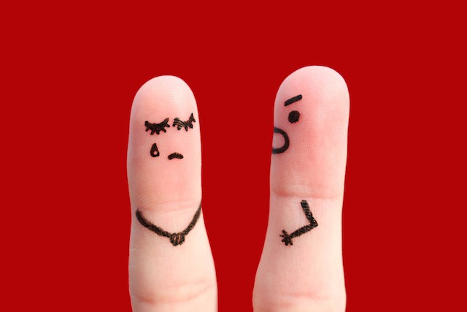
Stress: how to reduce?
Don’t pressure others to do more
Putting less effort for CS2103/T doesn’t make someone a bad person.
Cheating, making false promises, being unreliable, being disruptive, etc. … do.
Have a honest conversation about how each member is bringing to the table (don’t ask why).
Notes:
Acknowledging Stress: Many students are already dealing with various challenges (financial, health, relationships, etc.). The course should not add more stress, especially within the team environment.
No Pressure on Team Members: Team members should not pressure each other to contribute more than they can. Everyone has the freedom to decide how much work they can handle, and that's acceptable.
Avoid Misleading Expectations: It's important that team members are clear about how much they plan to contribute. Pretending to take on equal work but failing to deliver is not acceptable and will be penalized.
Clear Communication: Teams need to openly communicate their goals. If a member aims for a lower grade, like a "B" or "C," they should share that with the group, and no one should question their reasons. This will help with project planning.
Individual Grades: Grades will be based on individual contributions, so as long as each member does their share, their grade will not be affected by the contributions of others. This ends the main lecture discussion.

